Slide 1
Project 1: Four Connect
Presented By:
Group:03
Coder: Jul Jalal Al-Mamur Sayor, ID: 1901029
Designer: Nishat Tasnim Shishir, ID: 1901030
Presenter: Fahim Shahriyar Prottoy, ID: 1901041

Slide 2
Table of contents
01
02
Project Demonstration
Project Description

Slide 3
Introduction
In this presentation we will explain the implementation of “Four Connect” Game, which is also known as two-player, fully observable, deterministic, zero-sum game. Players take turn in dropping discs from the top of an upright board until one player can connect four discs of the same color in a row horizontally, vertically or diagonally. It is typically played in a 7 X 6 board

Slide 4
01
Project Demonstration

Slide 5
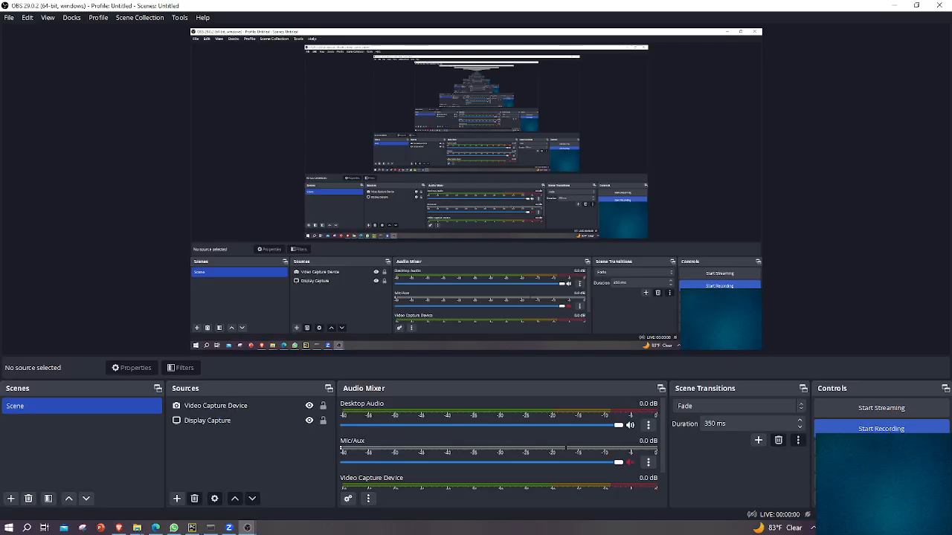

Slide 6
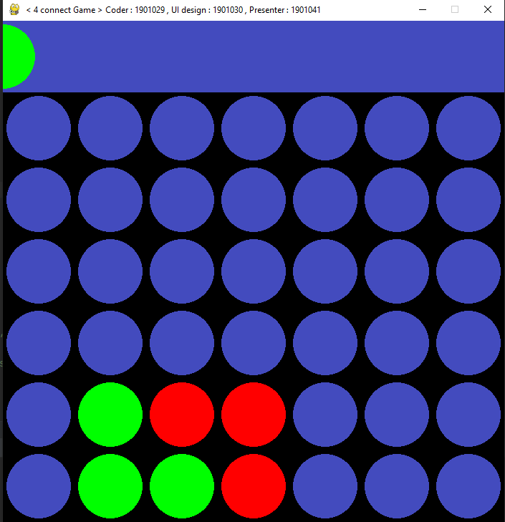
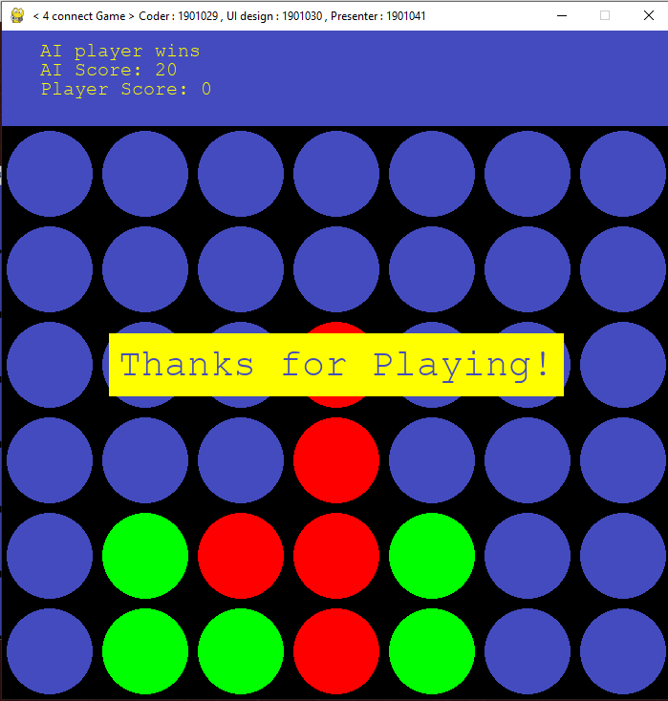
Playing the game
When Someone wins

Slide 7
02
Project Description

Slide 8
Necessary Libraries
Numpy
Random
Pygame
Sys
Math
pygame.mixer

Slide 9
Code Explanation

Slide 10
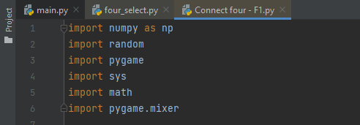
Importing Necessary libraries

Slide 11
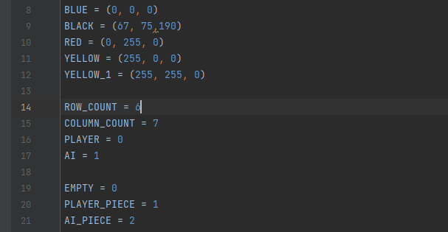
Setting Various Variable Values

Slide 12
Setting Various Variable Values

Slide 13
Customize the Title and loading music for both turns

Slide 14
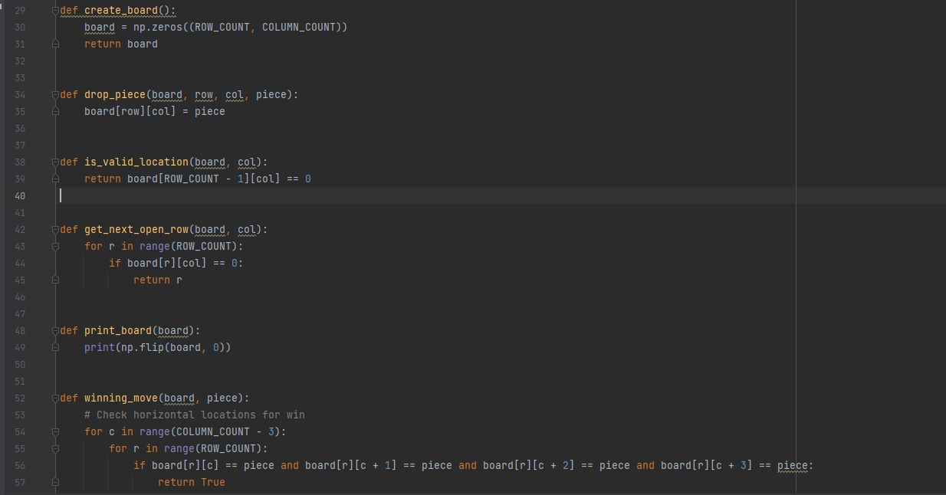
Game logic functions

Slide 15
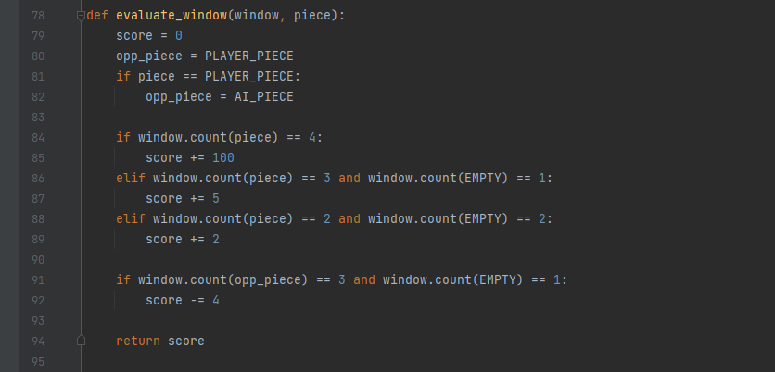
AI Evaluation and Scoring Functions:

Slide 16
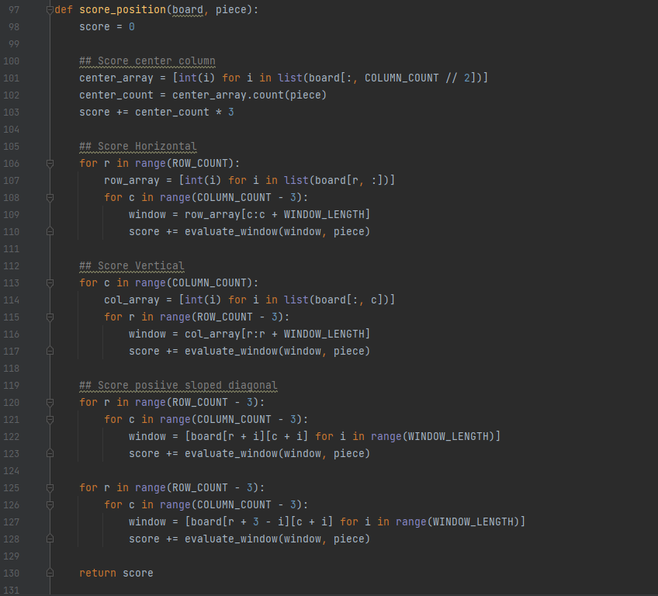
AI Evaluation and Scoring Functions:

Slide 17
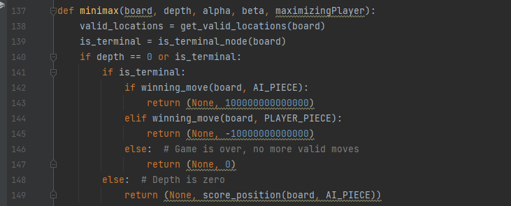
Applying min-max with alpha beta pruning (first part , full section is in code files)

Slide 18
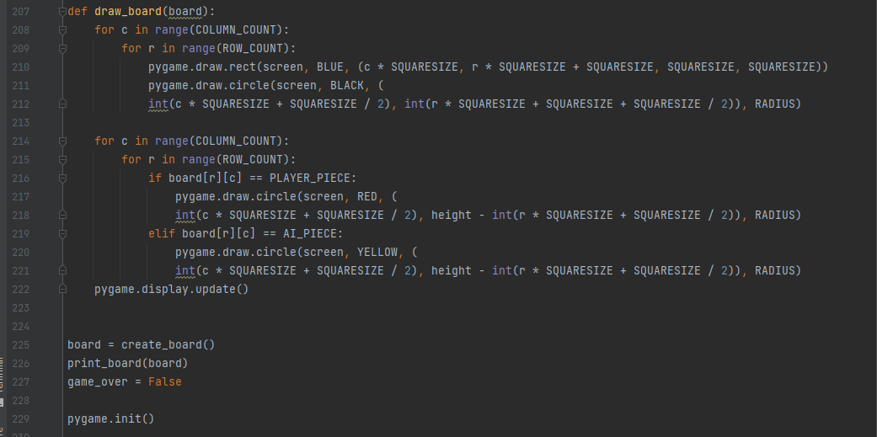
Drawing the Game Board

Slide 19
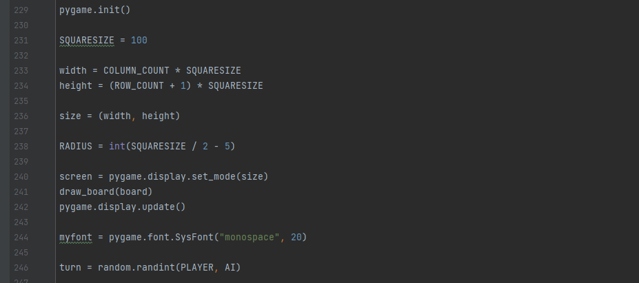
Pygame initialization and Game loop

Slide 20
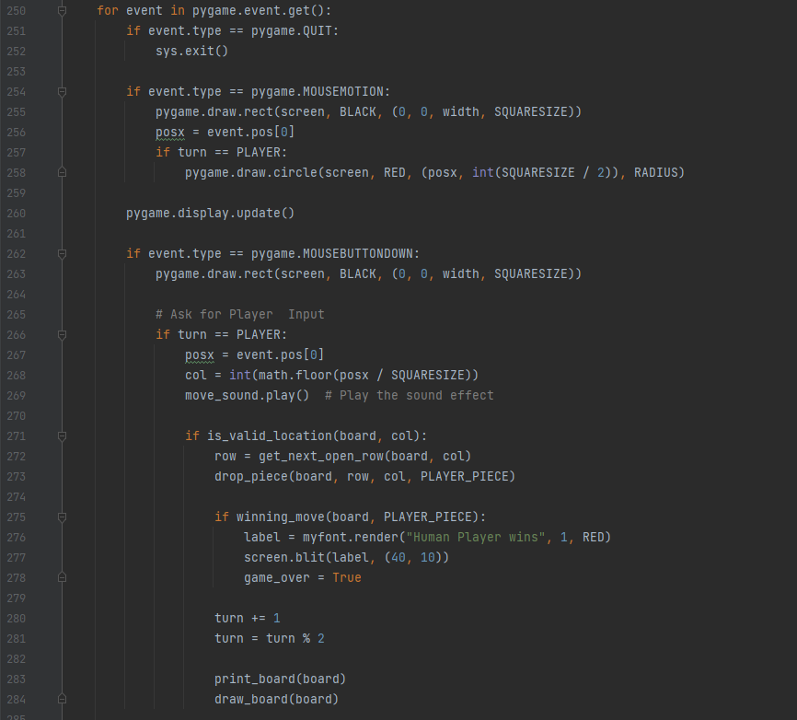
Players Turn

Slide 21
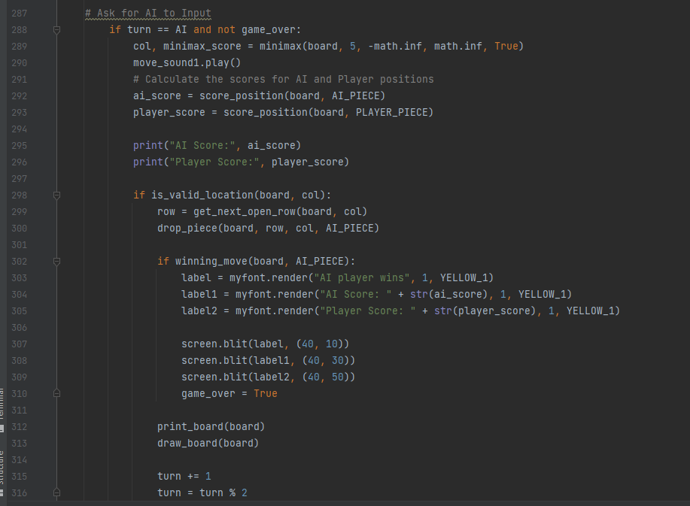
AI’s Turn

Slide 22
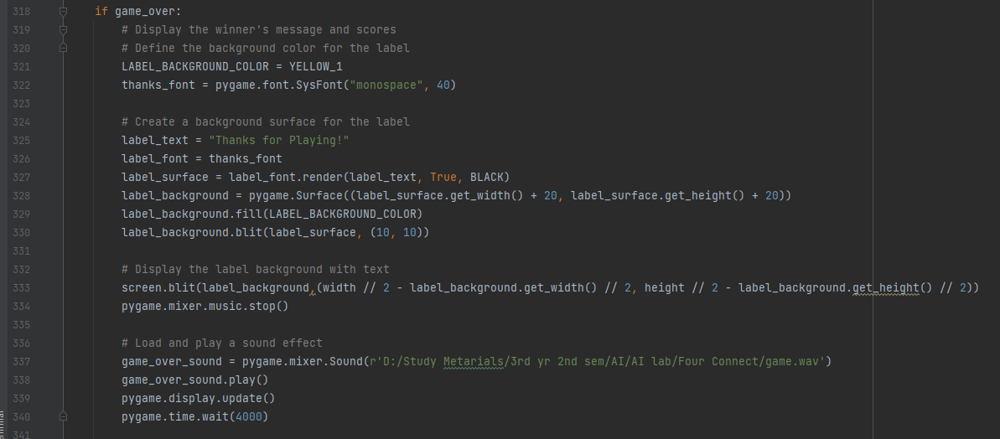
Game over handing

Slide 23
Thank You
Do you have any question?

